Slide 1
Comprehensive Cloud-Based Practice Management & Nutrient Analysis Software for Ayurvedic Dietitians, Tailored for Ayurveda-Focused Diet Plans
CSE7302- University Project
Review-2
Batch Number: CSE_191
Under the Guidance of,
MR. Arun Kumar
Assistant Professor
School of Computer Science and Engineering
Presidency University
Roll Number | Student Name
20221CSE0425 | N VISHAL
20221CSE0483 | PRAYAS MOHANTY
20221CSE0332 | PRAJWAL P
Name of the Program: Computer Science and Engineering
Name of the HoD: Dr. Blessed Prince
Name of the Program Project Coordinator: Mr. Muthuraj
Name of the School Project Coordinators: Dr. Sampath A K , Dr. Geetha A

Slide 2
Problem Statement Number: SIH25024
Student Innovation: Swadeshi for Atmanirbhar Bharat - MedTech / BioTech / HealthTech:
A Multimodal Emotion-Aware Conversational Agent for Mental Well-Being Using Audio-Visual Signals and Large Language Models.
Recent advances in artificial intelligence have enabled conversational agents to interact fluently with users however, these systems largely remain emotion agnostic.
This project focuses on designing a multimodal conversational agent that integrates
facial expression analysis
speech-based emotion recognition
Large language models
to infer emotional context and produce emotionally appropriate vocal responses, with an emphasis on mental well-being support.

Slide 3
Abstract
The Comprehensive Cloud-Based Practice Management & Nutrient Analysis Software addresses the limitations of manual, handwritten diet charts in Ayurvedic hospitals by providing a specialized platform for dietitians. It integrates modern nutrient tracking (calories, macros/micros) with core Ayurvedic principles like food properties (Hot/Cold, digestibility), six tastes (Rasa), and patient-specific dosha balancing.
Key capabilities include a database of 8,000+ foods across cuisines, automated generation of balanced diet charts and recipes, patient profiles tracking age/gender/habits/health metrics, secure cloud storage compliant with health regulations, mobile-friendly UX, HIS/EHR integration, and printable reports. This enables efficient, accurate, holistic dietary care tailored for men, women, and children

Slide 4
Literature Review
https://docs.google.com/document/d/1ZulgAKsm2S5jZItavX_UfWM3CI-ItzLa5PzM_TPYpz8/edit?usp=sharing
1. Coverage
Reviewed 10 research papers spanning:
Psychological foundations of emotion (FACS)
Facial Emotion Recognition (CNN-based FER)
Speech Emotion Recognition benchmarks
Multimodal emotion & sentiment analysis
Emotion-aware conversational systems
Large Language Models for adaptive dialogue
Real-world multimodal datasets (MELD, CMU-MOSEI)
2. Key Insights
Facial cues provide strong emotional signals but are sensitive to noise and occlusion.
Speech-based emotion captures tone and stress but struggles with speaker variability.
Text-based models understand semantics but miss non-verbal emotional cues.
Multimodal fusion significantly improves emotion recognition accuracy.
LLMs enable adaptive, context-aware responses but require explicit emotion conditioning.

Slide 5
Literature Review
3. Gap Identified
No existing system offers a real-time, fully integrated multimodal emotion-aware conversational agent that:
Dynamically fuses audio, video, and text emotions
Adapts responses emotionally during live interaction
4. Relevance to Proposed Work
Literature validates the need for multimodal emotion perception.
Highlights limitations of unimodal and static fusion approaches.
The proposed system addresses these gaps through confidence-weighted fusion and emotion-conditioned conversational AI.

Slide 6
Objectives
Primary Objectives
Develop a cloud-based platform to automate patient-specific Ayurvedic diet chart creation, replacing inefficient manual handwritten processes.
Integrate scientific nutrient analysis (calories, macros/micros) with Ayurvedic principles like six tastes (Rasa), food properties (Hot/Cold, digestibility), and dosha balancing.
Key Functional Objectives
Build a comprehensive database of 8,000+ foods from Indian/multicultural/international cuisines, customized for age/gender groups.
Enable automated generation of nutritionally balanced, Ayurveda-compliant diet plans and recipe-based charts with detailed analysis.
Create a patient management module capturing profiles, dietary habits, meal frequency, bowel movements, water intake, and health parameters.
Operational & Compliance Objectives
Ensure data security and privacy adhering to HIPAA/local health regulations.
Deliver intuitive UX for dietitians, with mobile/tablet support, HIS/EHR integration, and printable reporting tools.
Support scalable, on-the-go usage in Ayurvedic hospitals for holistic, accurate dietary care.

Slide 7
Existing Methods and Drawbacks
Existing methods for Ayurvedic diet prescription primarily involve manual, handwritten diet charts created by doctors in hospitals, based on patient consultations assessing doshas, tastes (Rasa), and food properties. Some digital nutrition apps exist for general tracking but rely on Western standards with basic calorie/macro logging.
Drawbacks of Existing Methods
Manual Inefficiencies: Handwritten charts are time-consuming, prone to errors, hard to update or share, and lack automated nutrient calculations or standardization.
Limited Ayurvedic Integration: Conventional software ignores Ayurvedic specifics like Hot/Cold properties, digestibility, six tastes, and dosha balancing, focusing only on macros/micros.
Cultural and Data Gaps: Food databases overlook Indian/regional cuisines, leading to inaccurate analysis and irrelevant recommendations.
​
Restrictiveness and Scalability Issues: Plans feel overly complex or inflexible; no patient management, mobile access, or compliance features like HIPAA.
.

Slide 8
Proposed Method and Feasibility Study
Proposed Method
Dynamic food database (8,000+ items) with dual-view panels showing nutritional data alongside Rasa, Guna, Virya, and dosha impact; drag-and-drop diet/recipe builder with real-time imbalance scoring.
Patient module for profiles (age, gender, habits, vitals); automated chart generation, NLP/CV for logging intake/symptoms, and FHIR APIs for HIS/EHR integration.
Tech stack: Flutter for cross-platform mobile/web apps, AWS/Azure/GCP cloud, AI for recommendations/parsing, HIPAA-compliant security, and BI dashboards for reports.

Slide 9
Proposed Method and Feasibility Study
Feasibility Study
Technical Feasibility
Achievable with established tech: Flutter for mobile/web apps, AWS/Azure/GCP for scalable cloud hosting, AI/ML (RAG/NLP/CV) for recommendations and logging, FHIR APIs for integrations—proven in Ayurveda pilots like Ayush Grid and Smart Diet India, with MVP buildable in 3-6 months. Challenges like data accuracy are mitigated via proprietary feedback loops and classical text knowledge graphs.
Operational Feasibility
Aligns seamlessly with workflows via intuitive UX, mobile access, and practitioner feedback loops (e.g., beta with 10-15 dietitians); supports hospital scalability through multi-user scheduling and real-time analytics, as seen in platforms like Ayurgrid. Regulatory compliance (HIPAA/FHIR) and training needs are low due to familiar interfaces.
Economic Feasibility
Cost-effective: Cloud reduces hardware (~50% savings), phased rollout (Phase 1: $50K-100K for core portal) yields ROI via subscriptions/pilots; government support (Ministry of Ayush schemes) aids funding, with market growth in Ayurveda digital health (e.g., startups like Patanjali, NirogStreet). Break-even projected in 12-18 months post-launch.

Slide 10
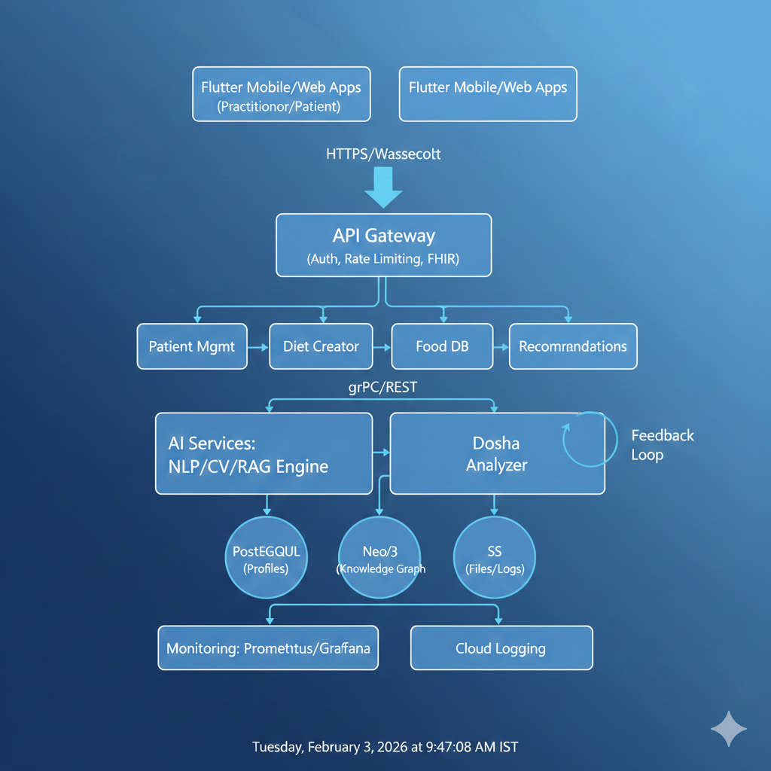
Architecture Diagram

Slide 11
Modules
Core Modules
Practitioner Portal: Web-based dashboard (Next.js/NestJS) for login, patient profile creation (age, gender, dosha, habits), drag-and-drop diet chart builder with real-time dosha scoring, recipe creation, and PDF exports.
Food Database Module: 8,000+ items with dual panels—Ayurvedic properties (Rasa, Guna, Virya, Hot/Cold) mapped to nutritional data (calories, macros/micros) from INDB/IFCT sources.​
Patient Mobile App: Flutter cross-platform app for meal logging (NLP voice/text, CV photo analysis), symptom tracking (energy, digestion, mood), reminders, and interactive plans.
Backend & AI Modules
Patient Management: Profiles with health metrics (bowel, water intake); FHIR APIs for HIS/EHR integration and multi-user scheduling.
AI Engine: RAG/NLP/CV for recommendations, parsing logs, and predictive analytics from feedback loops; knowledge graph for Ayurvedic-modern data fusion.
Analytics & Reporting: BI dashboards, printable charts, and aggregated insights for practitioners.
​
Infrastructure Modules
Security & Compliance: OAuth/JWT auth, HIPAA/GDPR encryption, audit logs.
Admin Module: Data ingestion, user roles, and system monitoring

Slide 12
SDG Mapping
SDG | Goal Description | Project Alignment
SDG 3: Good Health & Well-being | Ensure healthy lives and promote well-being for all ages. | Enables precise, personalized Ayurvedic diet plans reducing lifestyle diseases via nutrient tracking, dosha balancing, and preventive care in hospitals.
SDG 2: Zero Hunger | End hunger, achieve food security, and improved nutrition. | Supports nutritionally balanced, culturally relevant meal plans using local/seasonal foods, tailored for diverse age/gender groups.
SDG 12: Responsible Consumption & Production | Ensure sustainable consumption and production patterns. | Promotes Ayurvedic principles of mindful eating with minimal waste, organic/local sourcing, and recipe optimization.

Slide 13
Hardware and Software Details
Hardware Requirements
Client-Side (Practitioner/Patient Devices): Standard laptops/desktops (Intel i5+ or equivalent, 8GB RAM, 256GB SSD) for web portals; smartphones/tablets (Android 10+ or iOS 14+, 4GB RAM) for mobile apps—no specialized hardware needed beyond cameras/microphones for AI logging.
Server-Side: Cloud-hosted (AWS EC2 t3.medium instances or equivalents) with auto-scaling; optional on-premise servers (16GB RAM, 4-core CPU, 500GB SSD) for small clinics.
Software Requirements
Frontend: Flutter (Dart) for cross-platform mobile apps; Next.js (React) for web dashboards with SSR/SSG for performance.
Backend: NestJS/Node.js microservices; PostgreSQL for profiles/charts, Neo4j for knowledge graphs, MongoDB for logs.
AI/ML: TensorFlow/PyTorch for NLP/CV/RAG engines; hosted on SageMaker or Vertex AI.
Infrastructure & Tools: Docker/Kubernetes orchestration, FHIR APIs, OAuth/JWT auth, HIPAA-compliant encryption; BI via Tableau integration.

Slide 14
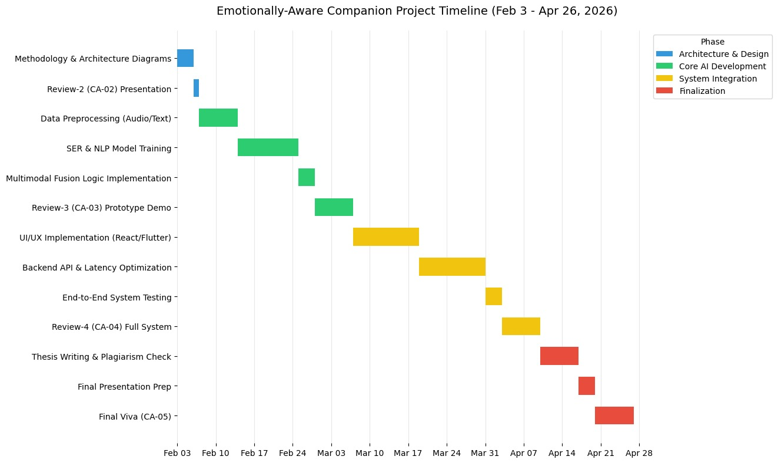
Timeline ( Gantt Chart )

Slide 15
Github Link
Github Link
https://github.com/team-university-projects/emotionally-aware-conversational-companion

Slide 16
References
P. Ekman and W. V. Friesen, “Facial action coding system: A technique for the measurement of facial movement,” Consulting Psychologists Press, 1978.
A. Mollahosseini, D. Chan, and M. H. Mahoor, “Going deeper in facial expression recognition using deep neural networks,” Proc. IEEE Winter Conf. on Applications of Computer Vision (WACV), pp. 1–10, 2016.
B. Schuller, S. Steidl, and A. Batliner, “The Interspeech 2009 emotion challenge,” Proc. Interspeech, pp. 312–315, 2009.
S. Poria, E. Cambria, D. Hazarika, and P. Vij, “Multimodal sentiment analysis: Addressing key issues and setting up baselines,” IEEE Intelligent Systems, vol. 33, no. 6, pp. 17–25, 2018.
T. Brown et al., “Language models are few-shot learners,” Advances in Neural Information Processing Systems (NeurIPS), vol. 33, pp. 1877–1901, 2020.
A. Zadeh, P. P. Liang, S. Poria, E. Cambria, and L.-P. Morency, “Multimodal language analysis in the wild: CMU-MOSEI dataset and benchmarks,” Proc. Annual Meeting of the Association for Computational Linguistics (ACL), pp. 226–236, 2018.
D. Hazarika, S. Poria, A. Zadeh, E. Cambria, R. Zimmermann, and R. Mihalcea, “MELD: A multimodal multi-party dataset for emotion recognition in conversations,” Proc. ACL, pp. 527–536, 2020.
L. Pepino, P. Riera, and L. Ferrer, “Emotion recognition from speech using Wav2Vec 2.0 embeddings,” Proc. Interspeech, pp. 3400–3404, 2021.
A. Mollahosseini, B. Hasani, and M. H. Mahoor, “AffectNet: A database for facial expression, valence, and arousal,” IEEE Transactions on Affective Computing, vol. 10, no. 1, pp. 18–31, 2019.
Y. Zhou, Z. Wang, C. Zhang, and X. Chen, “Emotion-aware chatbot using attention-based neural networks,” IEEE Access, vol. 7, pp. 86673–86684, 2019.

Slide 17


